Slide 1
Experimental Details
Used samples: 1;2;3;4;5;6;7;8;9;10;X and Y.
Plasma volume: 20 µl.
Type of Cancer: unknown.
Concentration: unknown.
Size Distribution: unknown.
Experimental duration: 60 min.
Antibody used: CD9, CD81, and CD63.

Slide 2
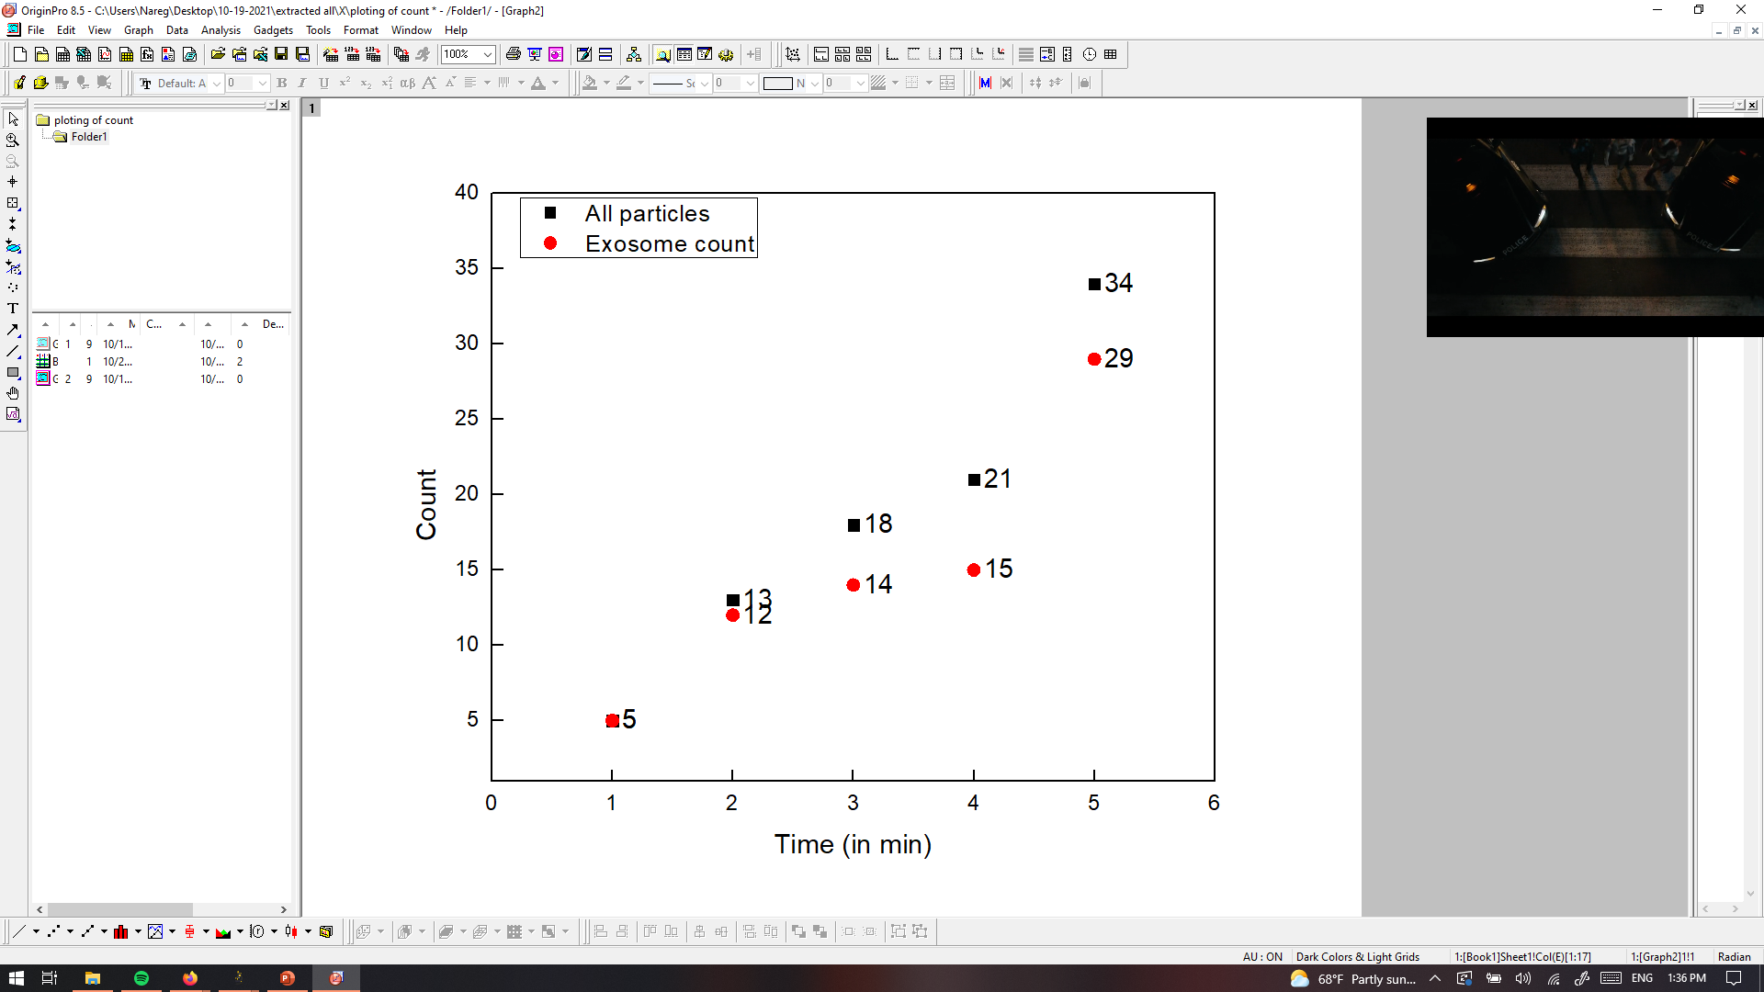
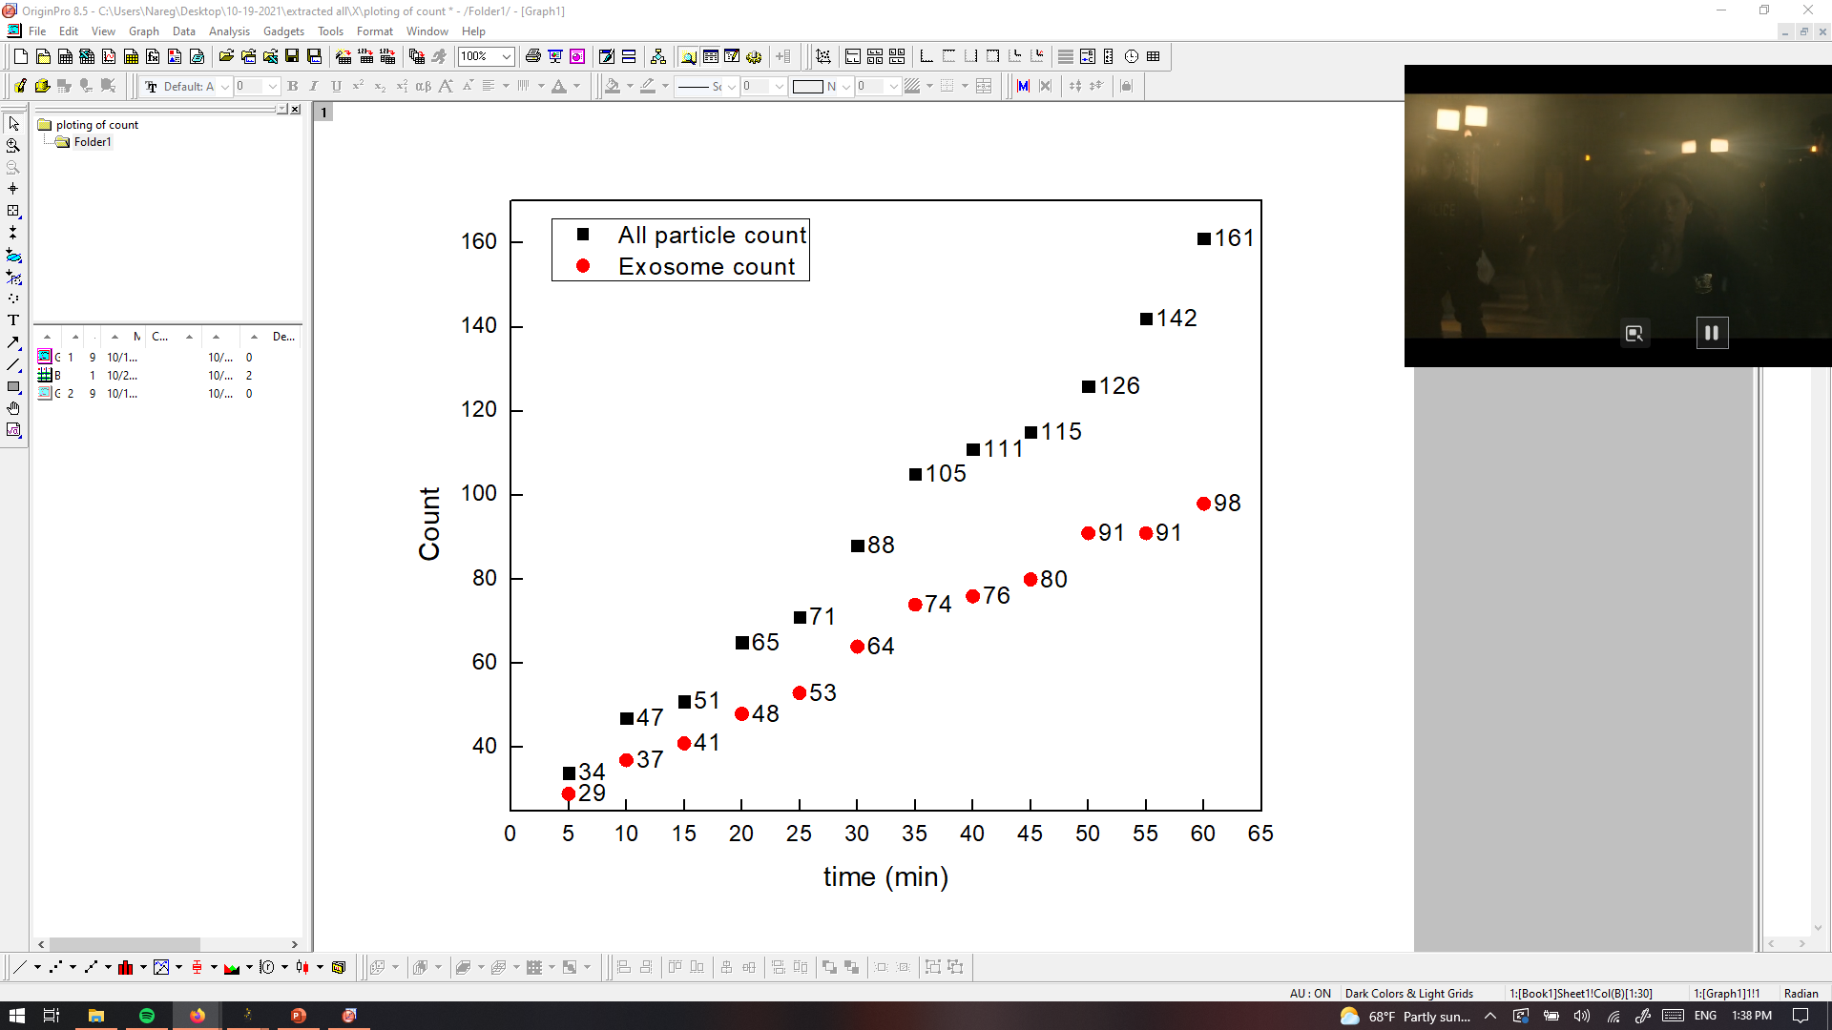
PANRORAMA of Plasma Sample X=002? (prediction Healthy)
Time: 10 min
Time: 20 min
Time: 30 min
Particle count at 5 min intervals
Time: 40 min
Time: 50 min
Time: 60 min
Scale bar: 10 µm

Slide 3
PANRORAMA of Plasma Sample X=002? ( prediction Healthy)
Time: 60 min
Count: 171
Time: 60 min wash
Count: 74
2nd time
Before wash: 185
After wash: 67
Note: No response to miRNA-21 mb
Scale bar: 10 µm

Slide 4
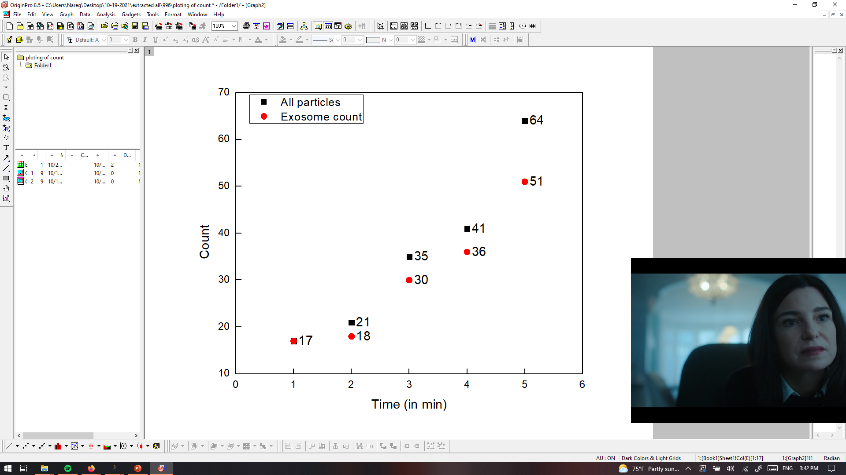
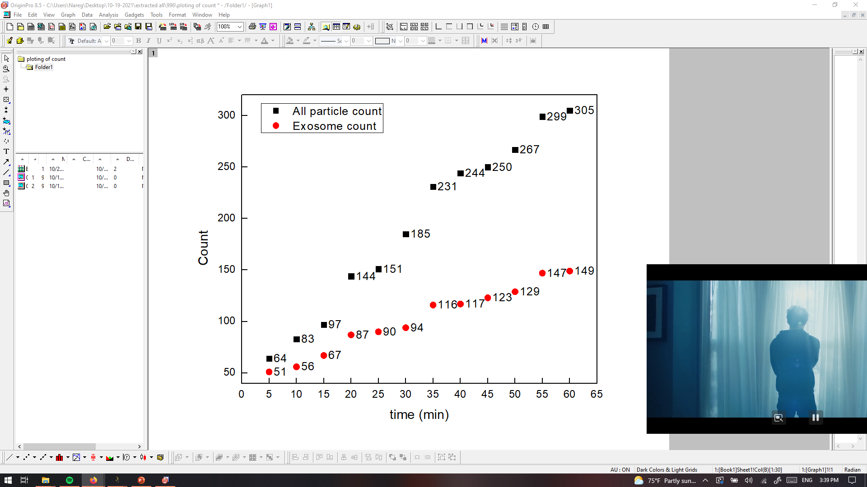
PANRORAMA of Plasma Sample Y=996? (Prediction Cancer)
Time: 10 min
Time: 20 min
Time: 30 min
Particle count at 5 min intervals
Time: 40 min
Time: 50 min
Time: 60 min
Scale bar: 10 µm

Slide 5

PANRORAMA of Plasma Sample Y=996? (Prediction Cancer)
Time: 60 min
Count: 305
Time: 60 min wash
Count: 136
Note: No response to miRNA-21 mb
Scale bar: 10 µm

Slide 6
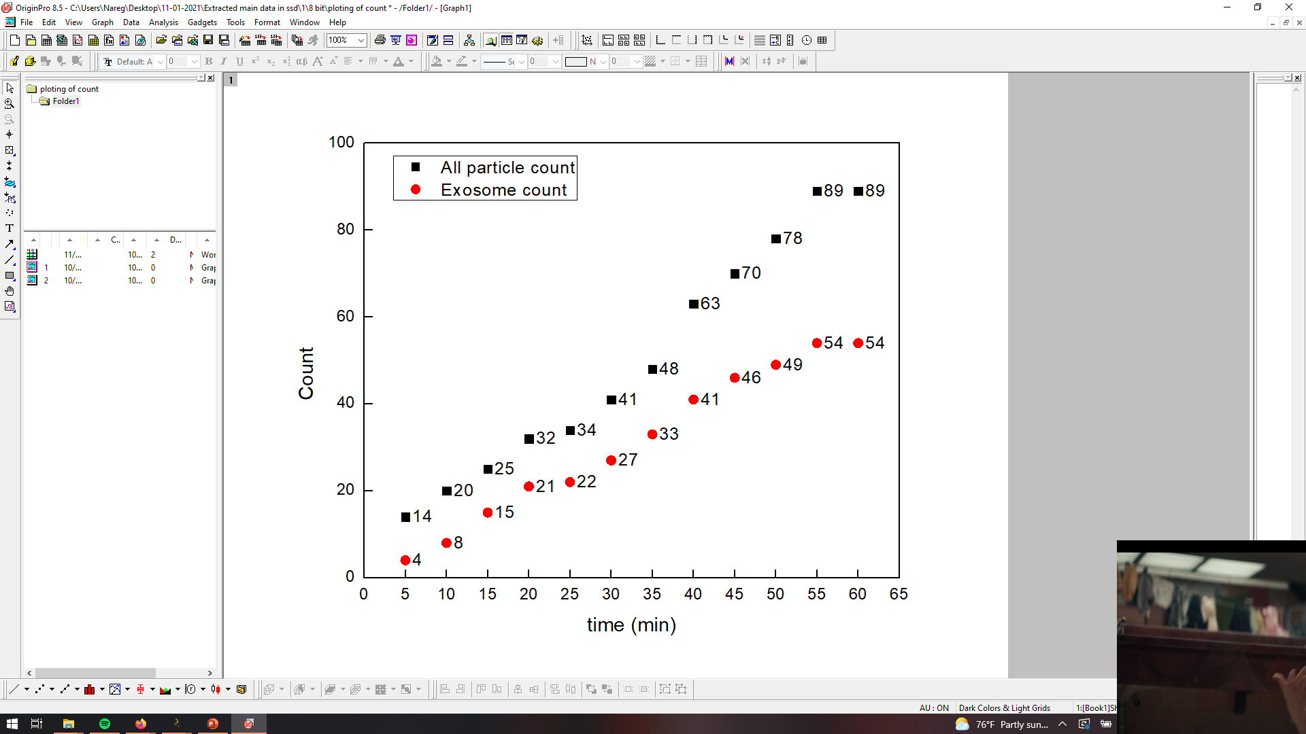
PANRORAMA of Plasma Sample 1 (Cursed)
Time: 10 min
Time: 20 min
Time: 30 min
Particle count at 5 min intervals
Time: 40 min
Time: 50 min
Time: 60 min
Scale bar: 10 µm

Slide 7

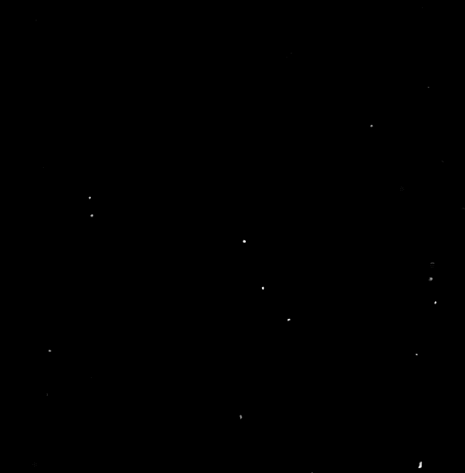
PANRORAMA of Plasma Sample 1 (healthy)
Time: 60 min
Count: 396
Time: 60 min wash
Count: 105
Note: No response to miRNA-21 mb
Scale bar: 10 µm

Slide 8
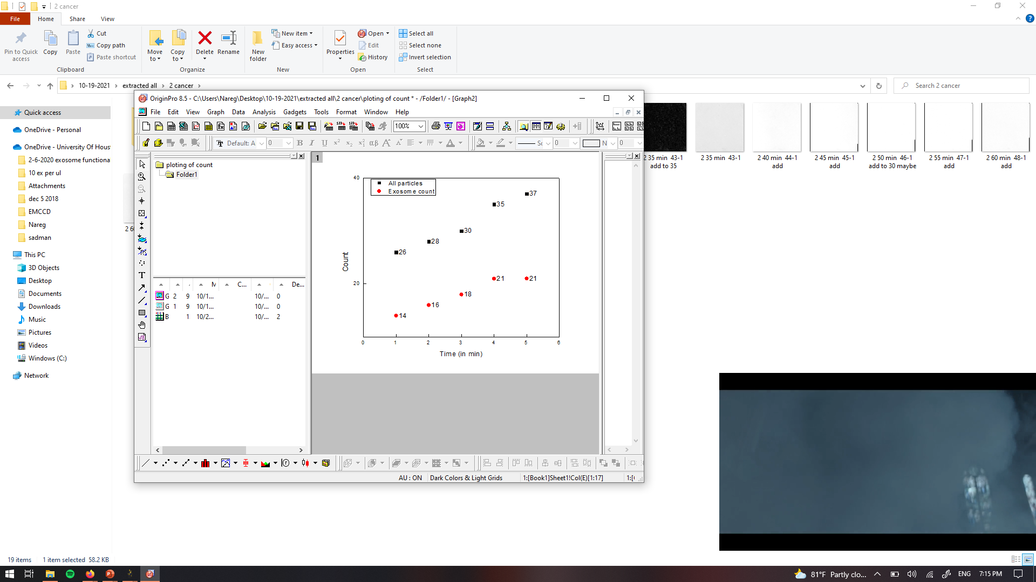
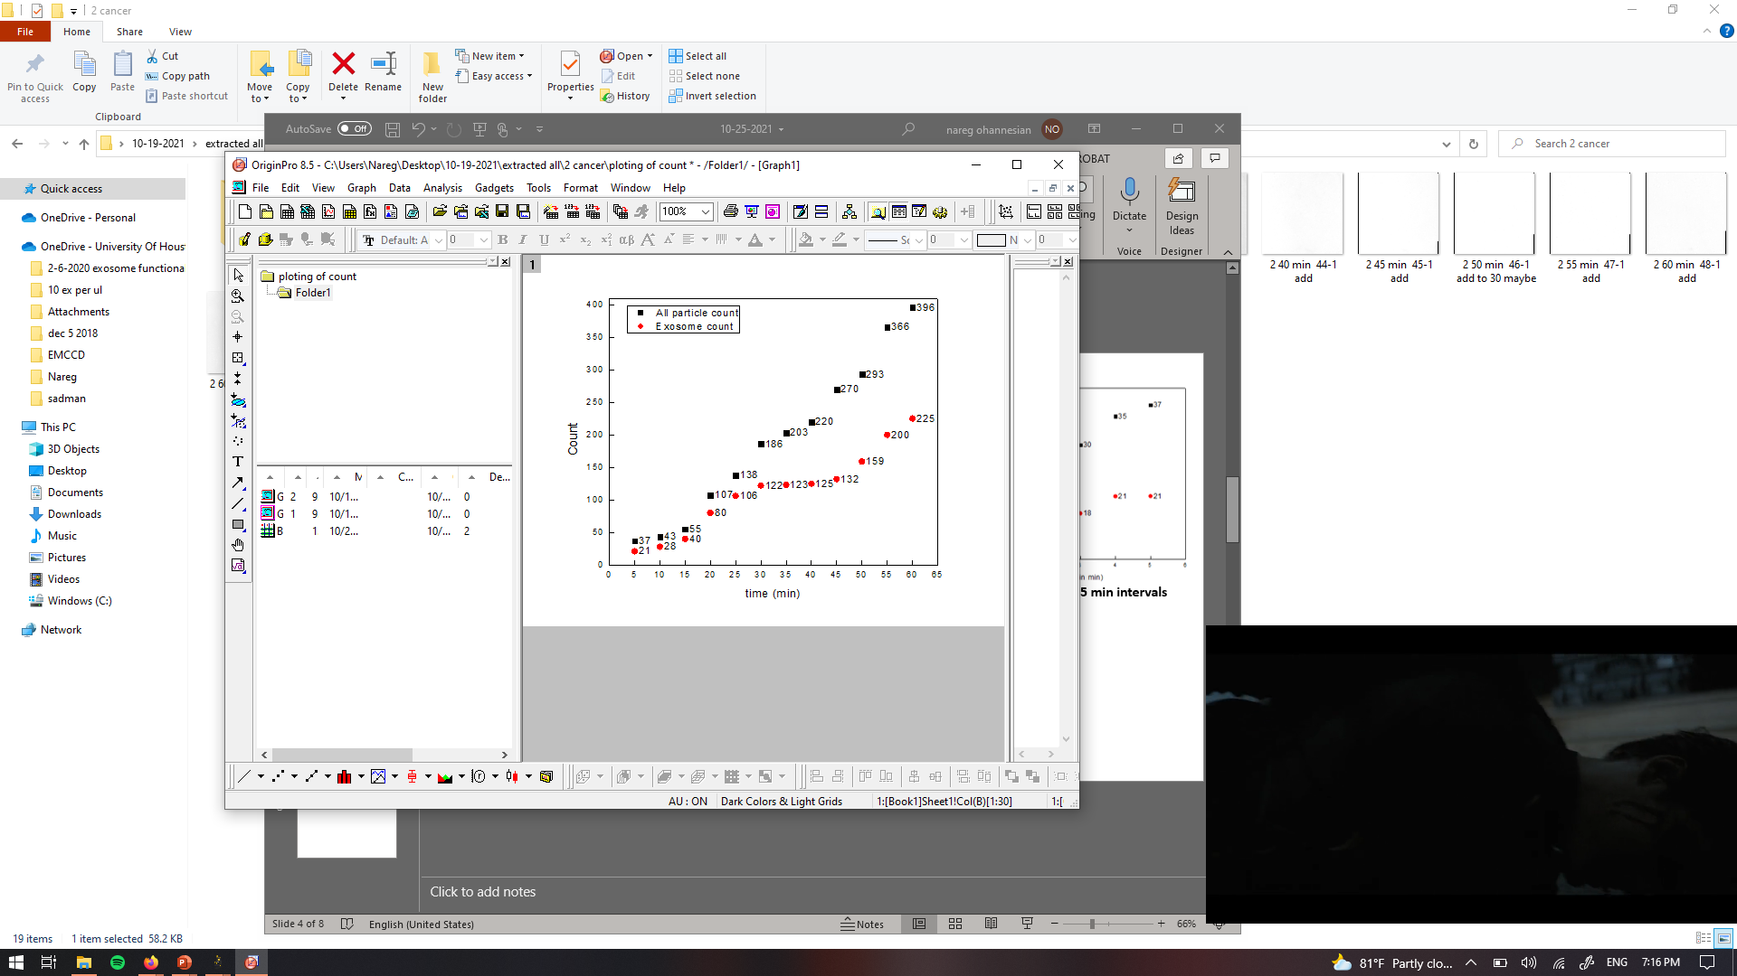
PANRORAMA of Plasma Sample 2 (Cancer)
Time: 10 min
Time: 20 min
Time: 30 min
Particle count at 5 min intervals
Time: 40 min
Time: 50 min
Time: 60 min
Scale bar: 10 µm

Slide 9


PANRORAMA of Plasma Sample 2 (Cancer)
Time: 60 min
Count: 396
Time: 60 min wash
Count: 105
Note: No response to miRNA-21 mb
Scale bar: 10 µm

Slide 10
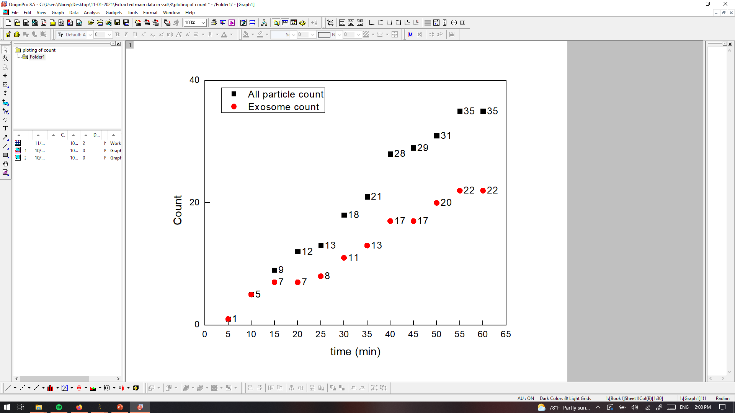
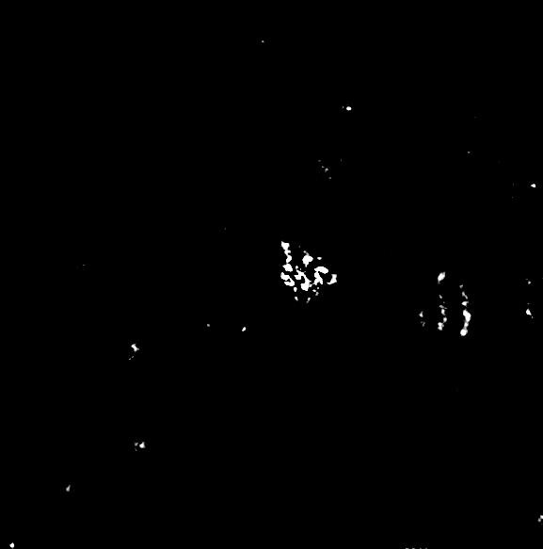

PANRORAMA of Plasma Sample 3 (healthy??)
Time: 60 min
Count: 35
Time: 60 min wash
Count: 7
Note: No response to miRNA-21 mb
Scale bar: 10 µm

Slide 11
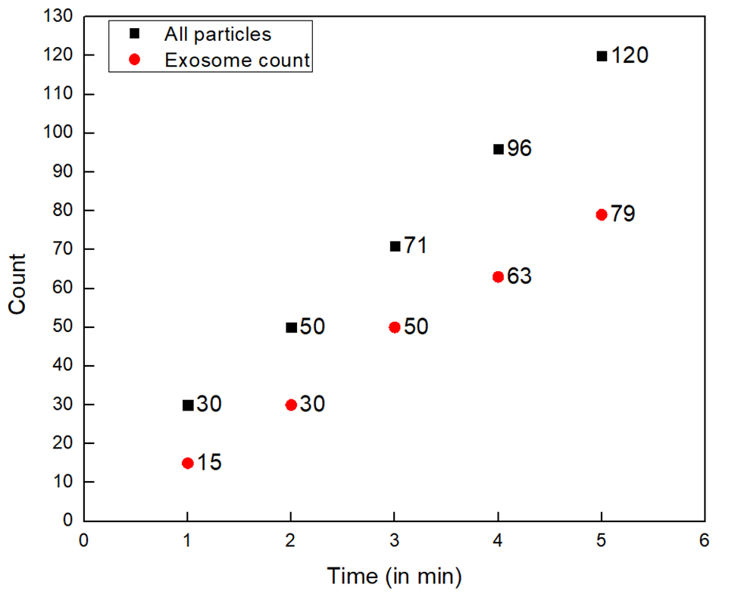
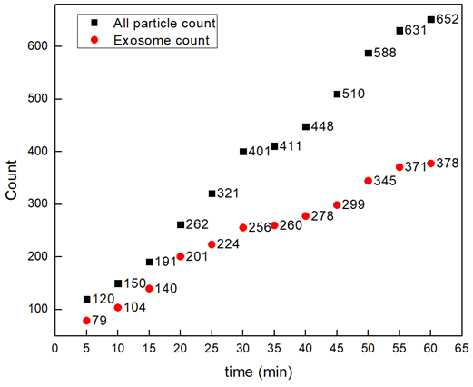
PANRORAMA of Plasma Sample 4 (Cancer)
Time: 10 min
Time: 20 min
Time: 30 min
Particle count at 5 min intervals
Time: 40 min
Time: 50 min
Time: 60 min
Scale bar: 10 µm

Slide 12

PANRORAMA of Plasma Sample 4 (Cancer)
Time: 60 min
Count: 396
Time: 60 min wash
Count: 201
Note: No response to miRNA-21 mb
Scale bar: 10 µm

Slide 13
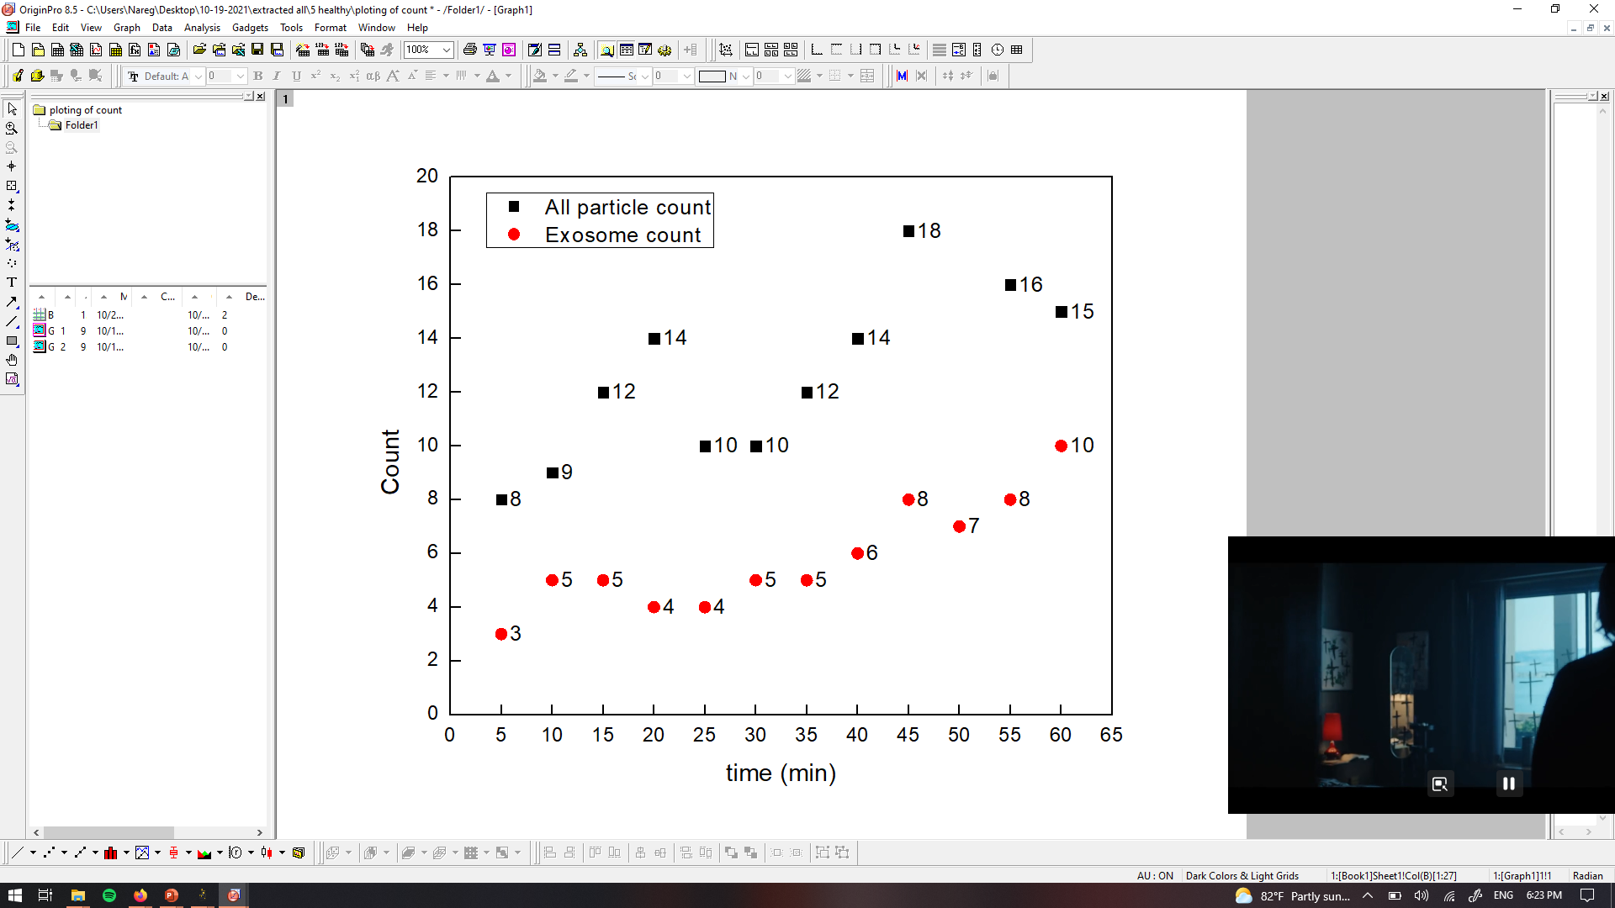
PANRORAMA of Plasma Sample 5 (Healthy)
Time: 60 min
Count: 15
Time: 60 min wash
Count: 5
Note: No response to miRNA-21 mb
Scale bar: 10 µm

Slide 14



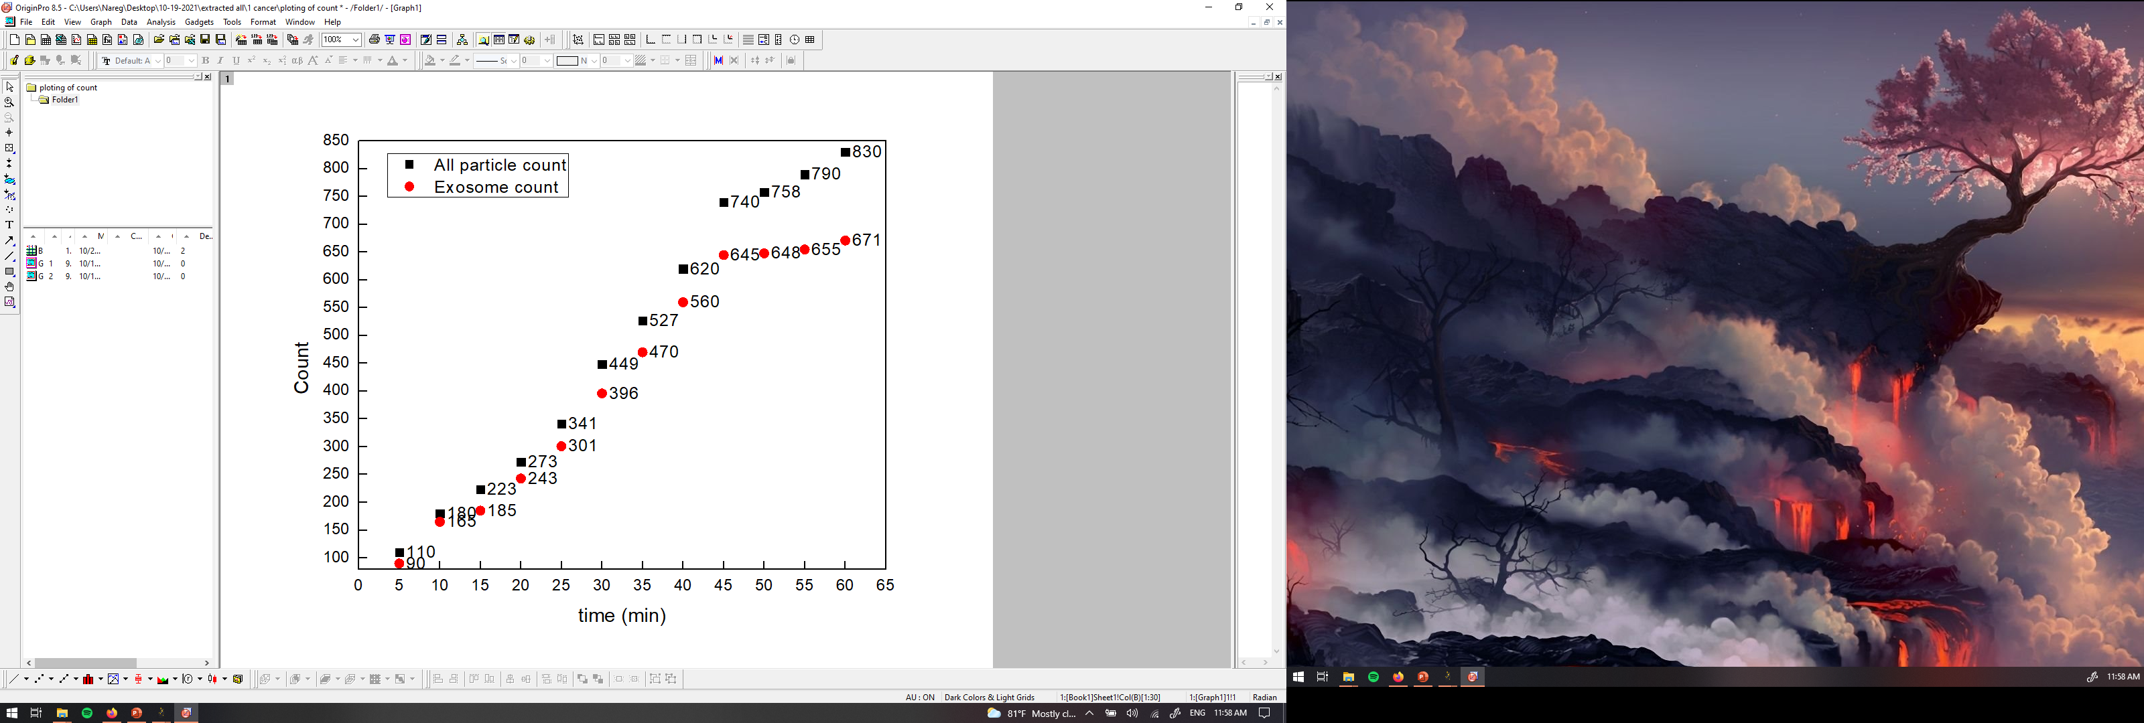


PANRORAMA of Plasma Sample 6 (Cancer)
Time: 10 min
Time: 20 min
Time: 30 min
Particle count at 5 min intervals
Time: 40 min
Time: 50 min
Time: 60 min
Scale bar: 10 µm

Slide 15
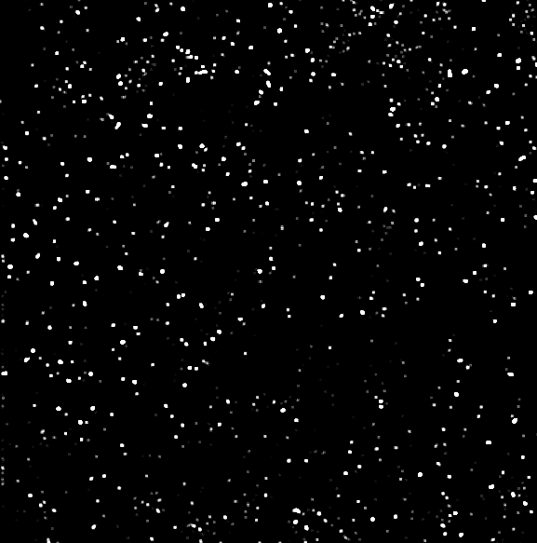

PANRORAMA of Plasma Sample 6 (Cancer)
Time: 60 min
Count: 830
Time: 60 min wash
Count: 404
Note: No response to miRNA-21 mb
Scale bar: 10 µm

Slide 16

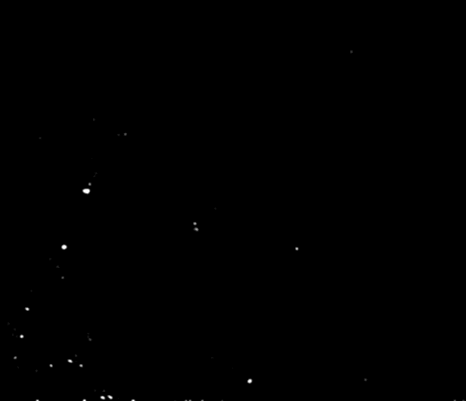
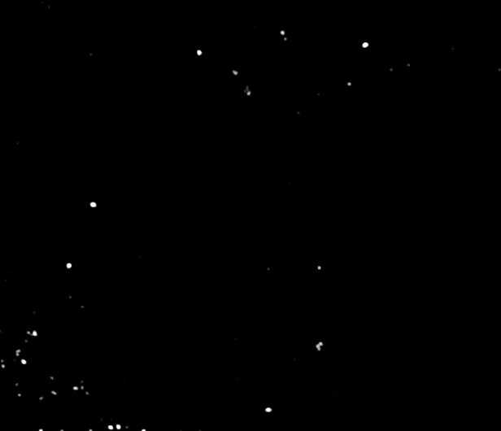
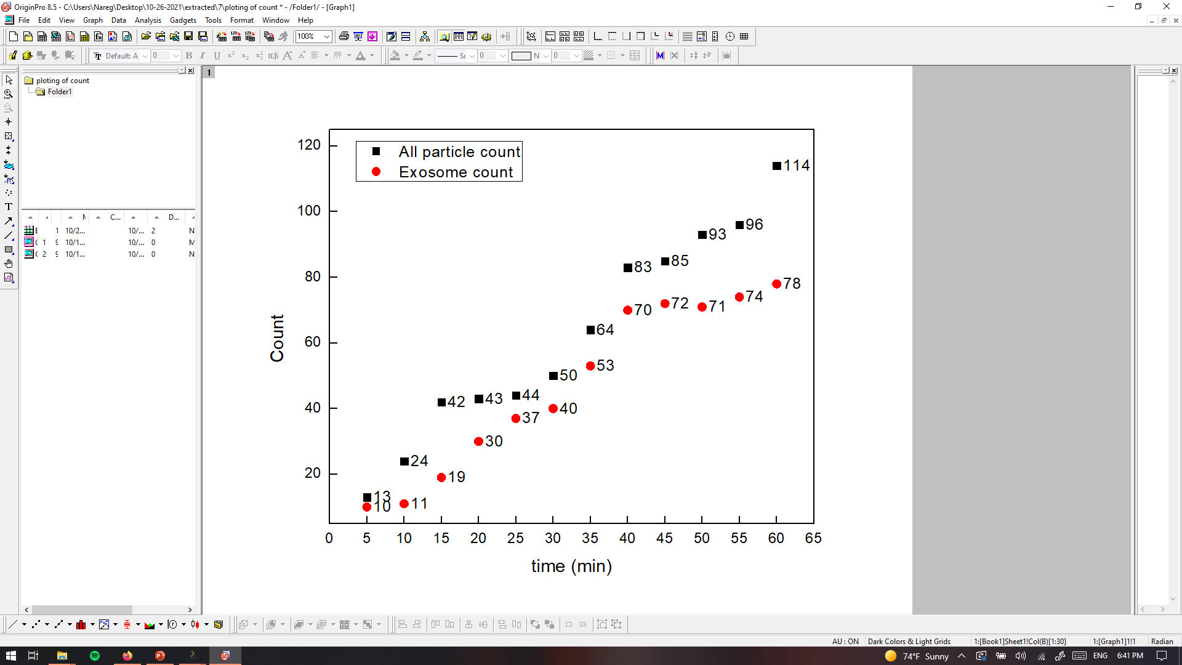
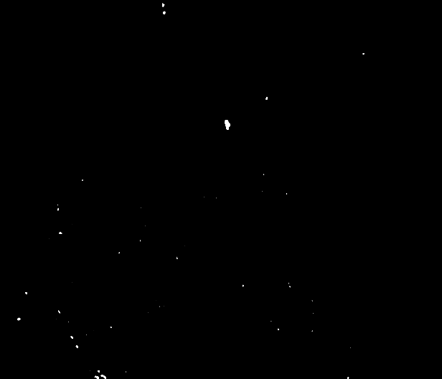
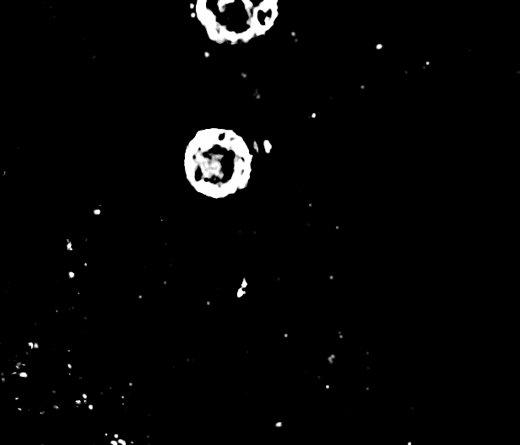
PANRORAMA of Plasma Sample 7 (Healthy)
Time: 10 min
Time: 20 min
Time: 30 min
Particle count at 5 min intervals
Time: 40 min
Time: 50 min
Time: 60 min
Scale bar: 10 µm

Slide 17

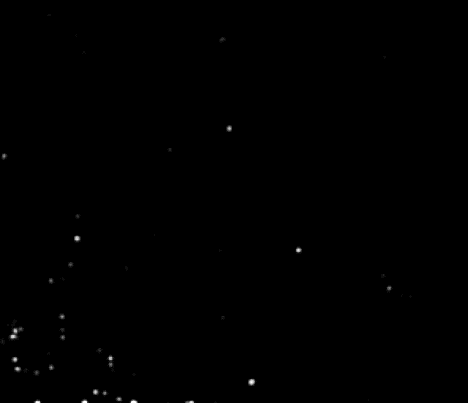
PANRORAMA of Plasma Sample 7 (Healthy)
Time: 60 min
Count: 114
Time: 60 min wash
Count: 33
Note: No response to miRNA-21 mb
Scale bar: 10 µm

Slide 18
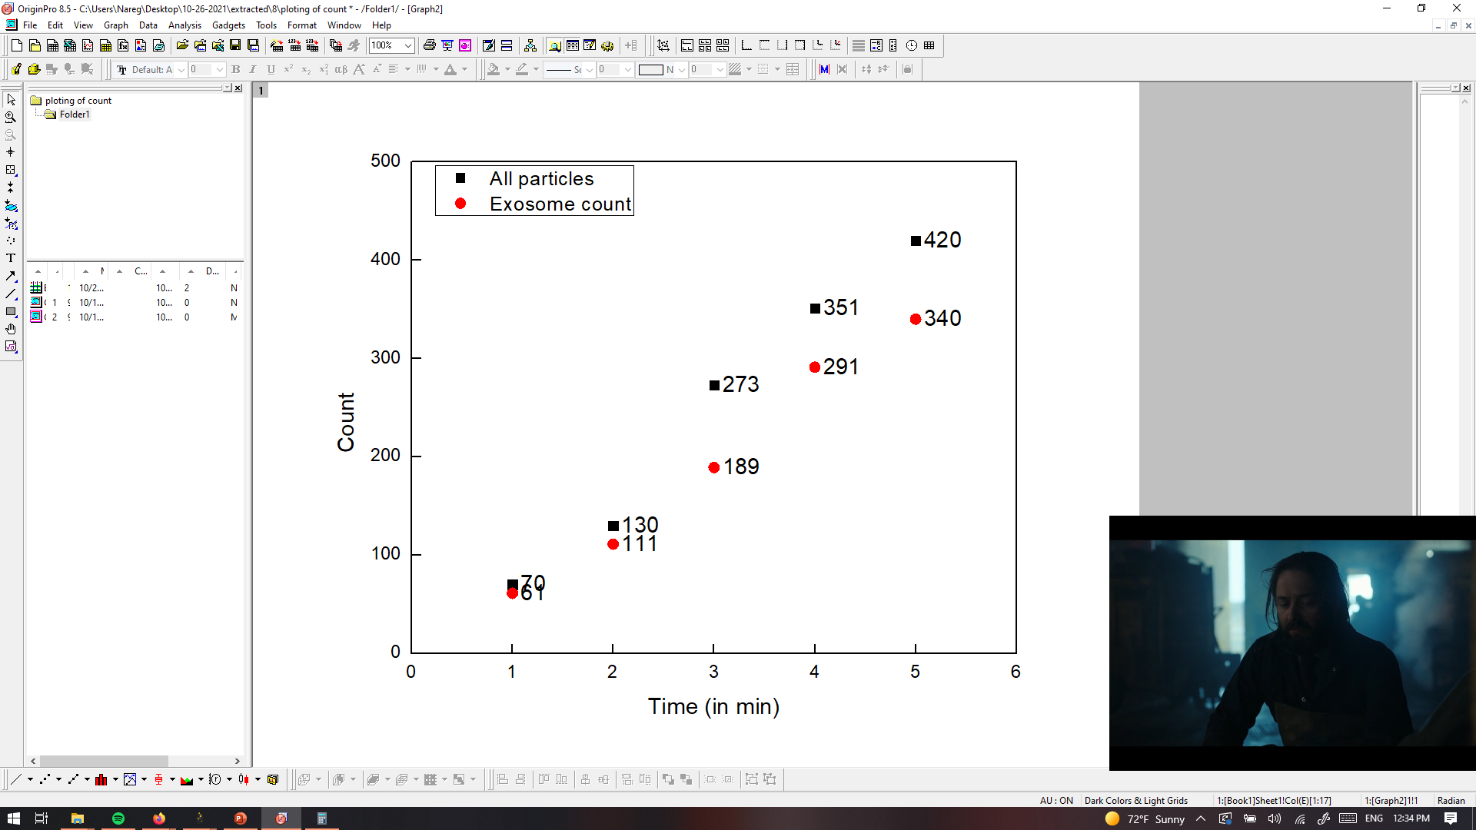
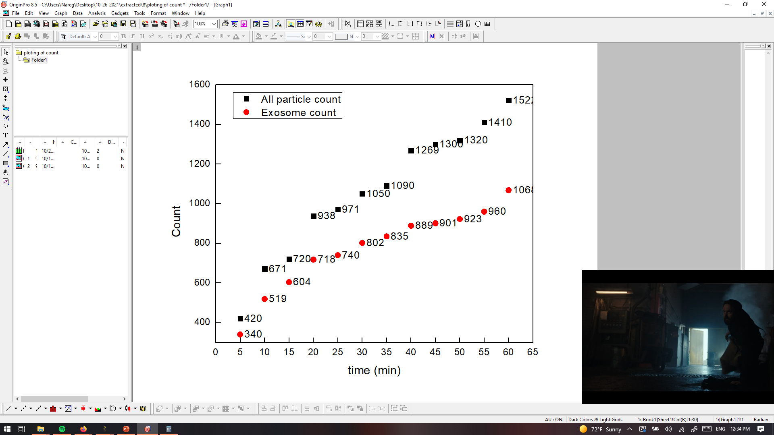
PANRORAMA of Plasma Sample 8 (Cancer)
Time: 10 min
Time: 20 min
Time: 30 min
Particle count at 5 min intervals
Time: 40 min
Time: 50 min
Time: 60 min
Scale bar: 10 µm

Slide 19

PANRORAMA of Plasma Sample 8 (Cancer)
Time: 60 min
Count: 1522
Time: 60 min wash
Count: 302
Note: 8% response to miRNA-21 mb
Scale bar: 10 µm

Slide 20
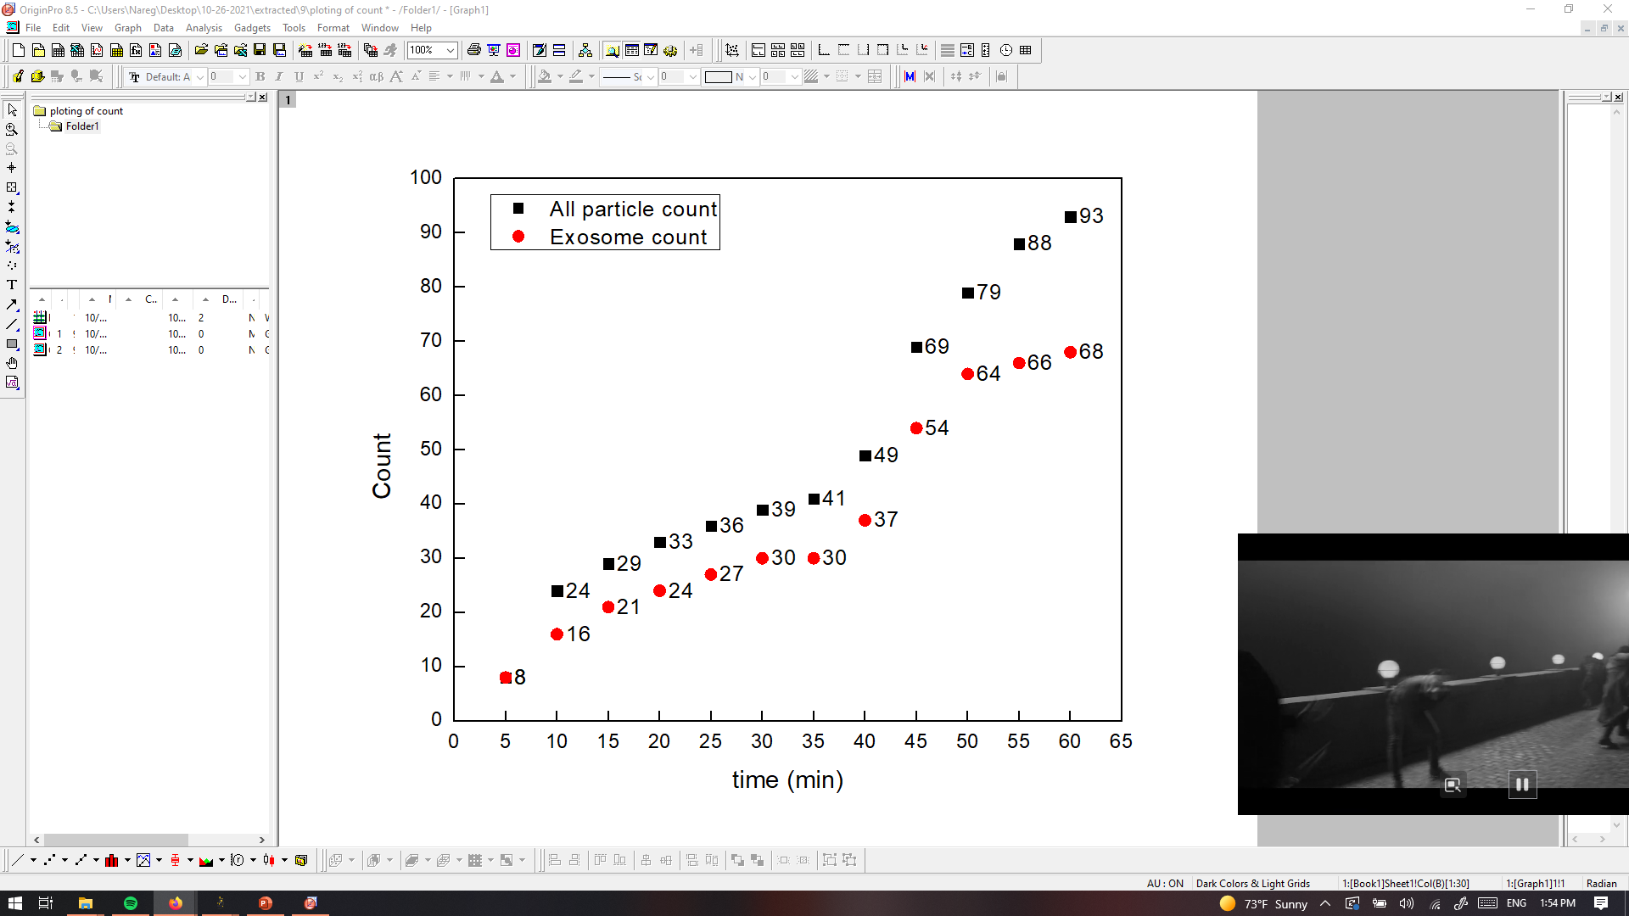
PANRORAMA of Plasma Sample 9 (Healthy)
Time: 60 min
Count: 93
Time: 60 min wash
Count: 46
Note: No response to miRNA-21 mb
Scale bar: 10 µm

Slide 21
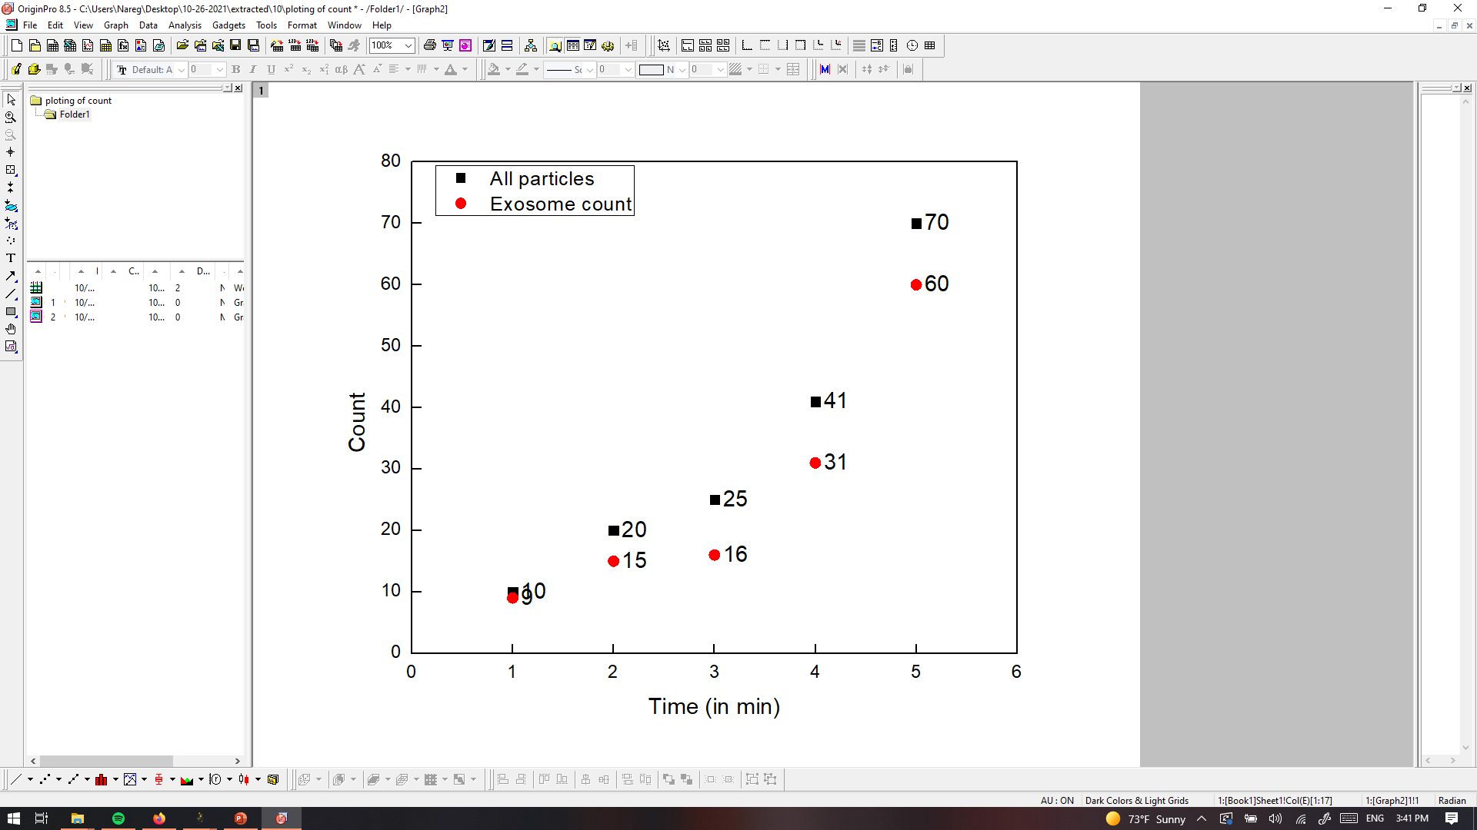
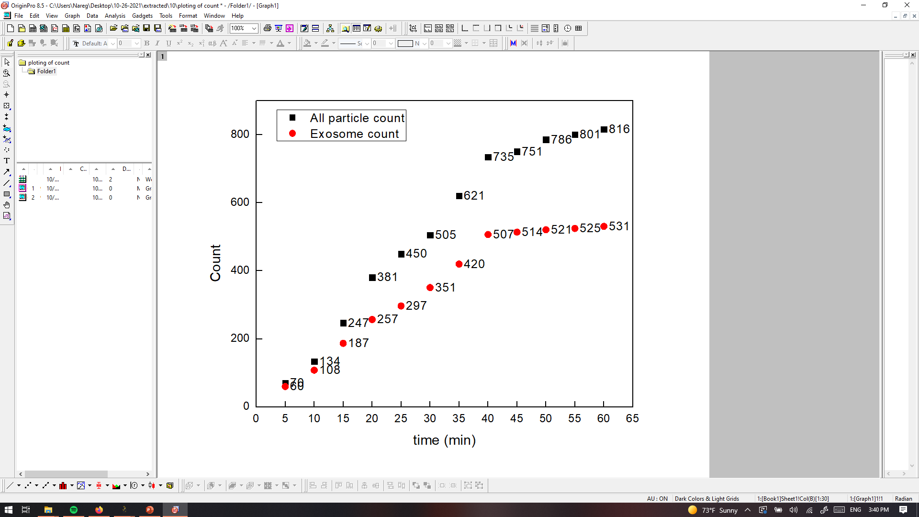
PANRORAMA of Plasma Sample 10 (Cancer)
Time: 10 min
Time: 20 min
Time: 30 min
Particle count at 5 min intervals
Time: 40 min
Time: 50 min
Time: 60 min
Scale bar: 10 µm

Slide 22
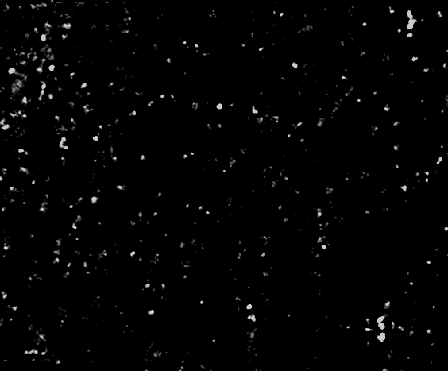
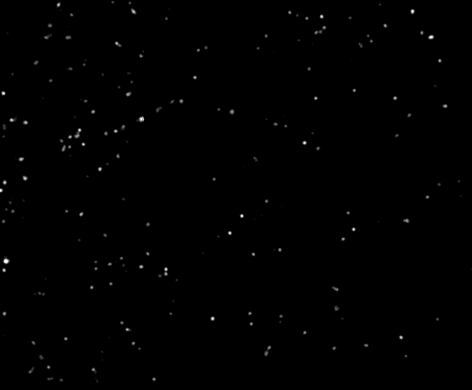
PANRORAMA of Plasma Sample 10 (Cancer)
Time: 60 min
Count: 816
Time: 60 min wash
Count: 208
Note: 4 % response to miRNA-21 mb
Scale bar: 10 µm

